Slide 1

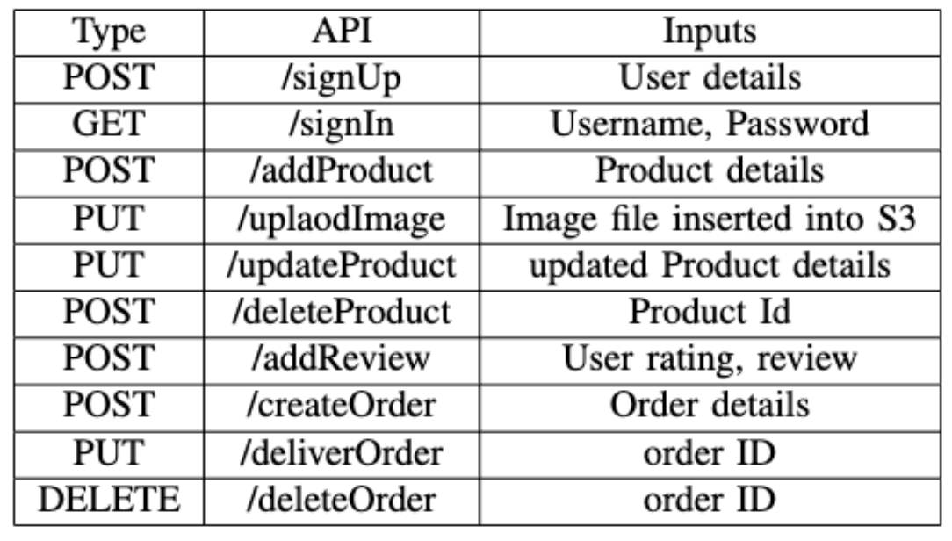
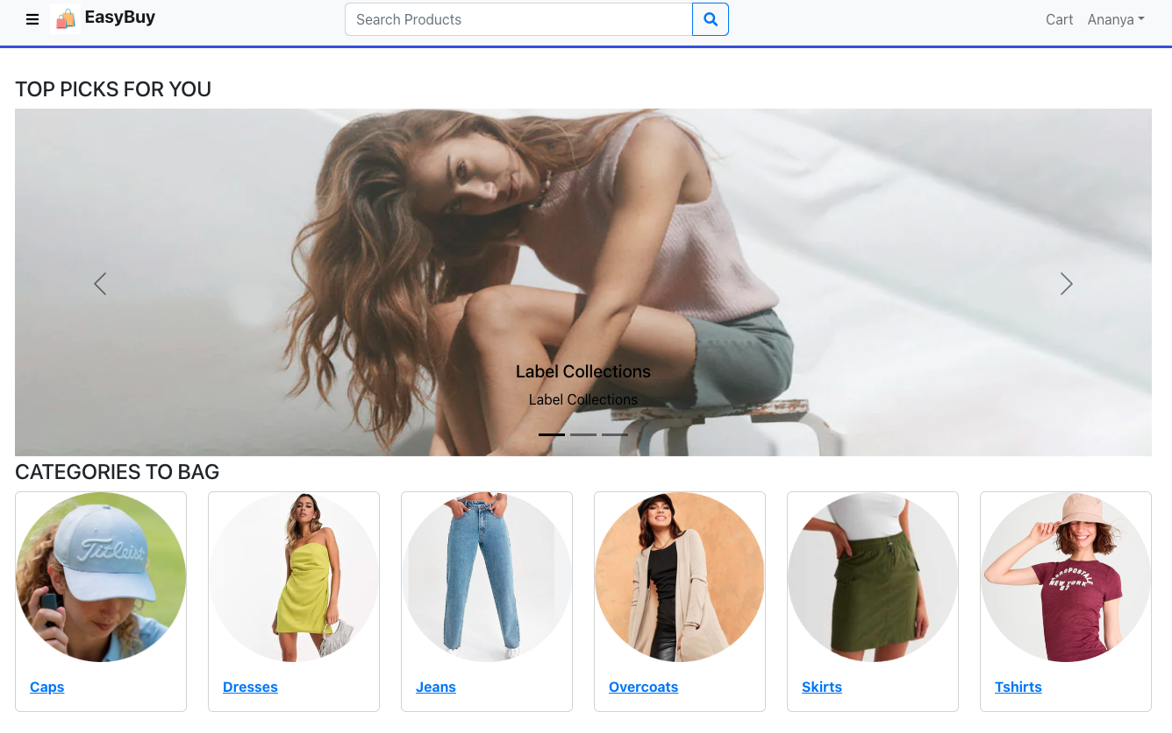
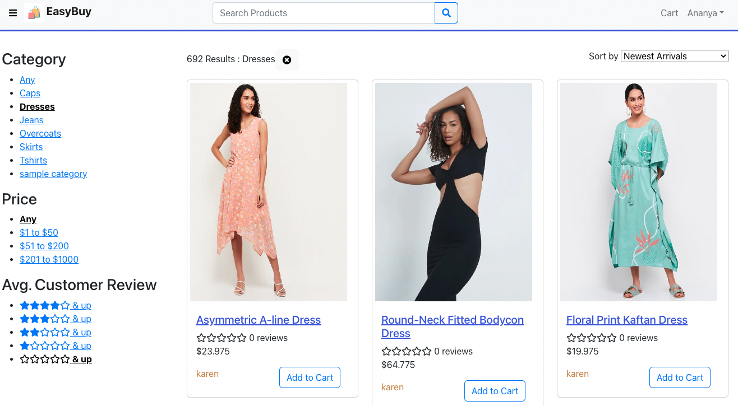
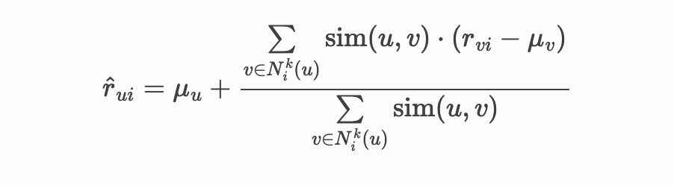
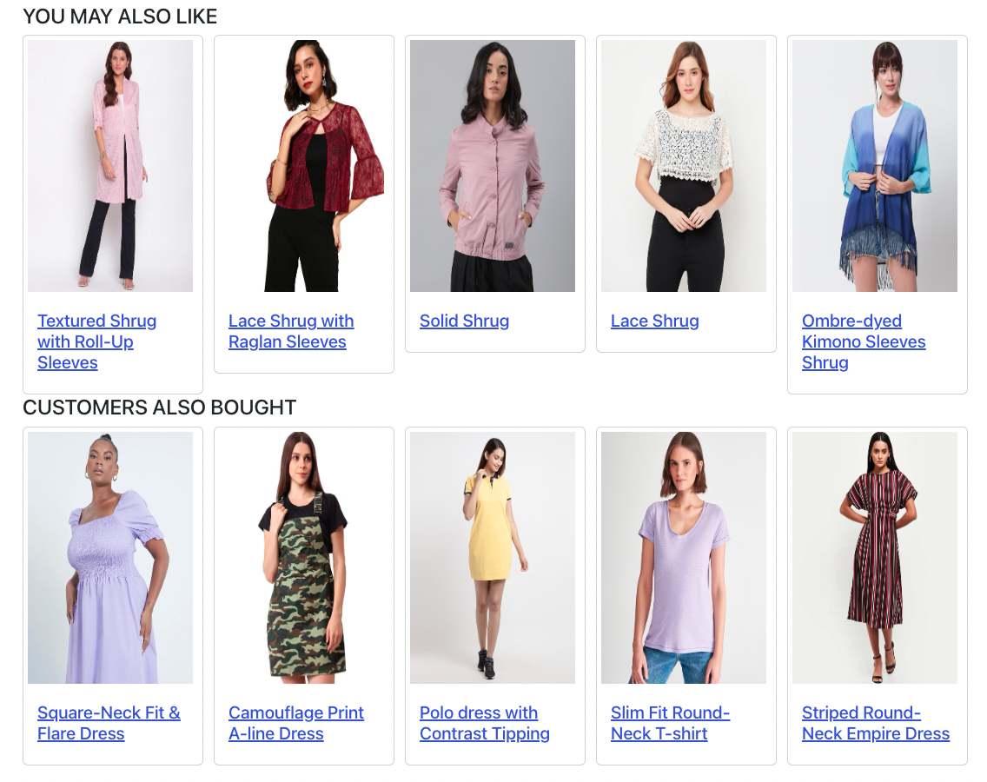
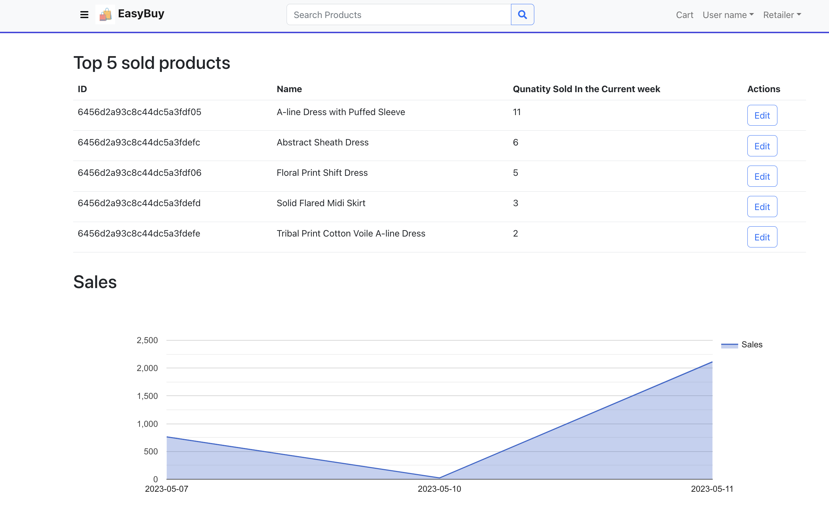
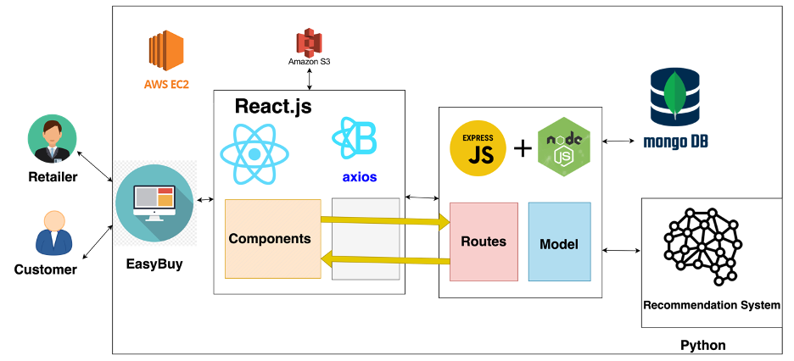
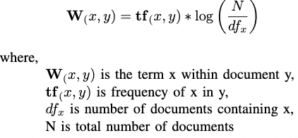
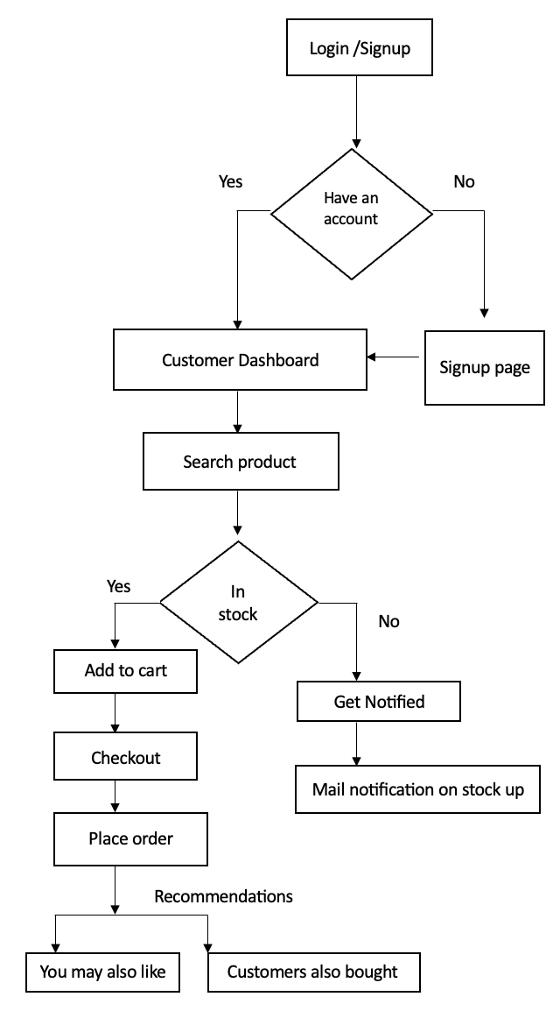
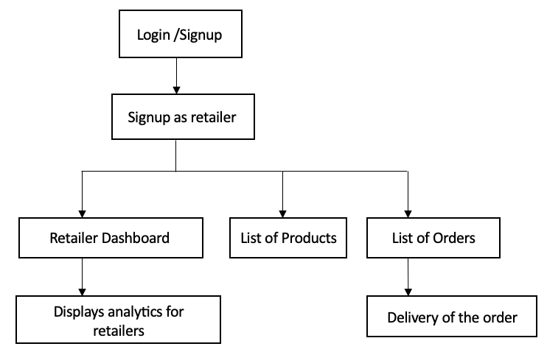
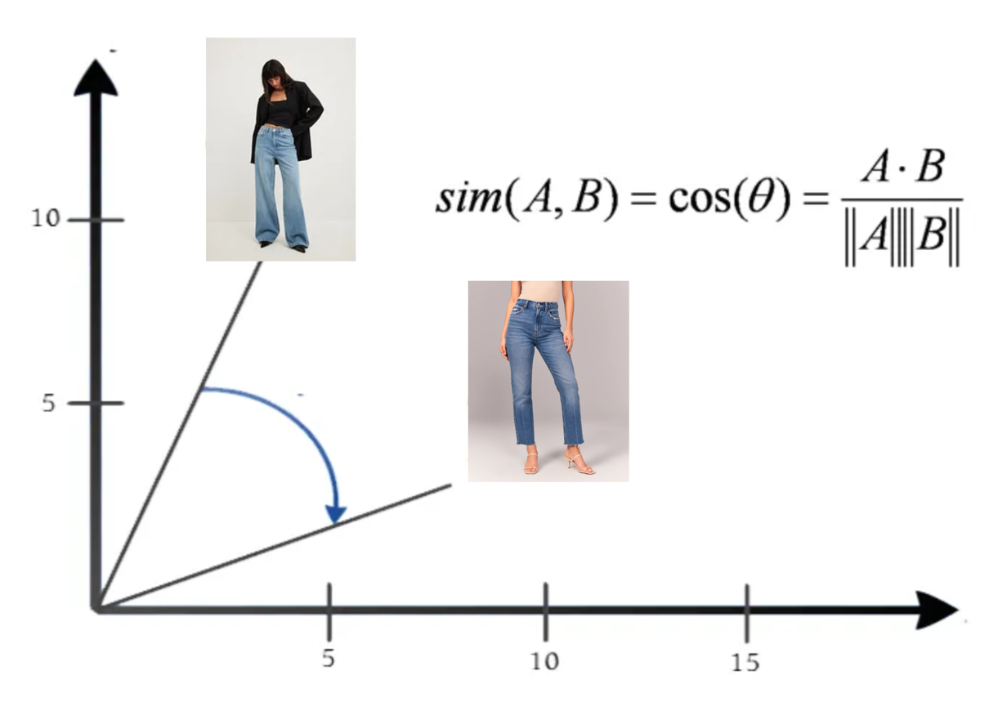
Computer Engineering Department
EASY BUY
Project Advisor: Dr. Wencen Wu
Annadatha, Annapurna Ananya
(MS Software Engineering)
Bobba, Manasa (MS Software Engineering)
Mandapati, Monica Lakshmi
(MS Software Engineering)
Reddem, Indhu Priya
(MS Software Engineering)
Introduction
Methods and Results
API Testing
At Easy Buy, we not only elevate your style but make shopping effortless. With a user-friendly interface, interesting product collections, and hassle-free checkout, we make it easy for you to create a memorable first impression with your fashion choices. Our platform analyzes customer preferences and suggests the top-rated items based on ratings from other shoppers.
The application consists of two user types: Customers and Retailers.
These are the functionalities offered by the application:
User authentication: The user should authenticate by providing his details on the Login/Sign-Up page to access the services.
Product Search: Customers can search for products based on the name and category. The searched products can be
filtered based on price, and ratings.
sorted based on the latest arrivals and price range.
2. Customers Also Bought: Used collaborative filtering to recommend products to a user based on the interests of similar users. Determined KNN with Means, which operates by identifying the k most similar users or items to a particular target user or item. It achieves this by comparing their rating patterns and preferences. Based on the average rating or score of these nearest neighbors, the algorithm generates recommendations for the target user or item.
All the backend APIs are tested using the postman and also performed functionality testing ensuring the application’s end-to-end flows are working.
Customer Dashboard:
We have included a notification feature for out-of-stock items so customers can be informed as soon as they're available again.
To help retailers stay on top of their inventory management, we're also providing a dashboard that displays the velocity of their products and calculates a marketing metric to give insights into market demand.
Summary/Conclusions
The platform we have developed goes beyond mere convenience by utilizing advanced algorithms to analyze customer preferences, enabling personalized recommendations based on ratings from other shoppers.
The platform assists retailers in managing their inventory effectively through a comprehensive dashboard. Overall, Easy Buy provides convenience, and data-driven decision-making to revolutionize the fashion retail experience.
Product Management:
Customers can
View the details of the product including price, description, ratings
Rate and review the product.
Add to the Cart or get notified if the product is out of stock.
Retailers can Add/Update and Delete the Products.
Retailer Dashboard: The Retailer Dashboard shows product and sales insights to the retailer. The first section shows the top 5 selling products of the current week along with its velocity. The second section shows the sales chart velocity which gives current market insights.
Architecture
Cart Management: Customers can add the products to the cart and can update the items in the cart.
Order Management: Customers can
View the order summary and can place the order.
See the status of the order and the list of previous orders.
The Retailer can see the orders placed and can deliver the order.
Recommendations: On placing the order, the algorithms are run and recommendations are generated which will be fetched on Dashboard.
1. You May Also Like: Used content-based filtering to recommend similar products. Calculated the TF-IDF score to determine the relevance of different products to individual customers based on their previous orders.
The diagram provided offers an overview of the comprehensive architecture of our project, having 4 major components: Front-end, Back-end, Recommendation system, and Database system, all of which work together to enable seamless functionality of the application.
Key References
[1] Verma, Ankit & Kapoor, Chavi & Sharma, Abhishek & Mishra, Biswajit. (2021). Web Application Implementation with Machine Learning. 423-428. 10.1109/ICIEM51511.2021.9445368.
[2] A. Verma, C. Kapoor, A. Sharma and B. Mishra, "Web Application Implementation with Machine Learning," 2021 2nd International Conference on Intelligent Engineering and Management (ICIEM), London, United Kingdom, 2021, pp. 423-428, doi: 10.1109/ICIEM51511.2021.9445368.
[3] Singh, Pradeep & Dutta Pramanik, Pijush & Dey, Avick & Choudhury, Prasenjit. (2021). Recommender Systems: An Overview, Research Trends, and Future Directions. International Journal of Business and Systems Research. 15. 14–52. 10.1504/IJBSR.2021.10033303.
Application Flow:
User. Retailer
The Front-end component is designed using the React.js library. The Back-end component of the application is be developed using Node.js, a robust JavaScript runtime environment for creating web applications.
The Recommendation system component of the application is developed using Python. Finally, the Database system component of the application is constructed using MongoDB.
Then calculated the cosine similarity and arrange them according to their similarity based on the input item. This scoring system allows us to generate personalized recommendations by suggesting products that align closely with the customer's interests and preferences.
Acknowledgements
We would like to express our sincere gratitude to Professor Dr. Wencen Wu for her guidance, support, and invaluable feedback throughout this research project. Her expertise and knowledge in the field have been instrumental in shaping our ideas and improving the quality of our work. We would like to extend our thanks to San Jose State University for providing the resources and facilities.

